Slide 1








INDIGOSHOP
Group No - 05
Group Members:
Shawly Rohman
Sadia Mobasshira
Jain Jannath
180104013
180104014
180104023
Presented By:
180104010
Simanta Sarker

Slide 2
Process Model
Every software developed is different and requires a suitable SDLC approach to be followed based on the internal and external factors. We used “Waterfall Model”.
Because:
Easy to use, simple and understandable.
Easy to manage as each phase has specific outputs and review process.
Clearly-defined stages.
Works well for smaller projects where requirements are very clear.
There are no ambiguous requirements.

Slide 3
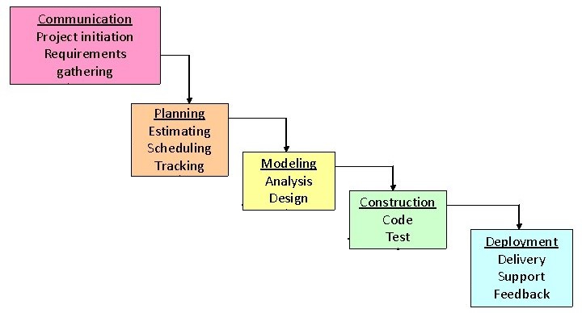
Process Model
Figure: Waterfall Model Diagram

Slide 4
Activities of the project
Visually represent our systems and processes.
Describing the interactions between the system.
Map out an existing system and find out the entities..
Establishing relationship between entities and databases or file storages
Decomposing the systems into several new systems to understand it properly.

Slide 5
Main Process and Sub process names, Entity names, DB Names
Context level / Level 0:
Entities: User, Admin, Staff.
Process: Indigoshop.
Level 1:
Entities: User, Admin, Staff.
Process: Registration, Login, Add Products, View Products, Order Products,
Check Order, Feedback, View feedbacks.
Database: Users, Orders, Products, Staffs, Feedbacks.

Slide 6
Main Process and Sub process names, Entity names, DB Names
Level 2:
Entities: User, Admin, Staff.
Process: Login.
Sub process: Login Details, Check user, Create new account.
Database: Users.
Process: Order Products.
Sub process: Check Login States, Add to cart, Place orders , Delivery orders.
Database: Orders.

Slide 7
Main Process and Sub process names, Entity names, DB Names
Level 2:
Entities: User, Admin, Staff.
Process: Add Products.
Sub process: Check Login States, Category List, Update products,
Database: Products.

Slide 8
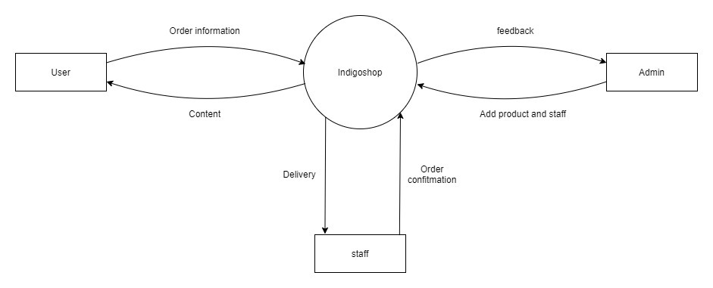
Context Level Diagram

Slide 9
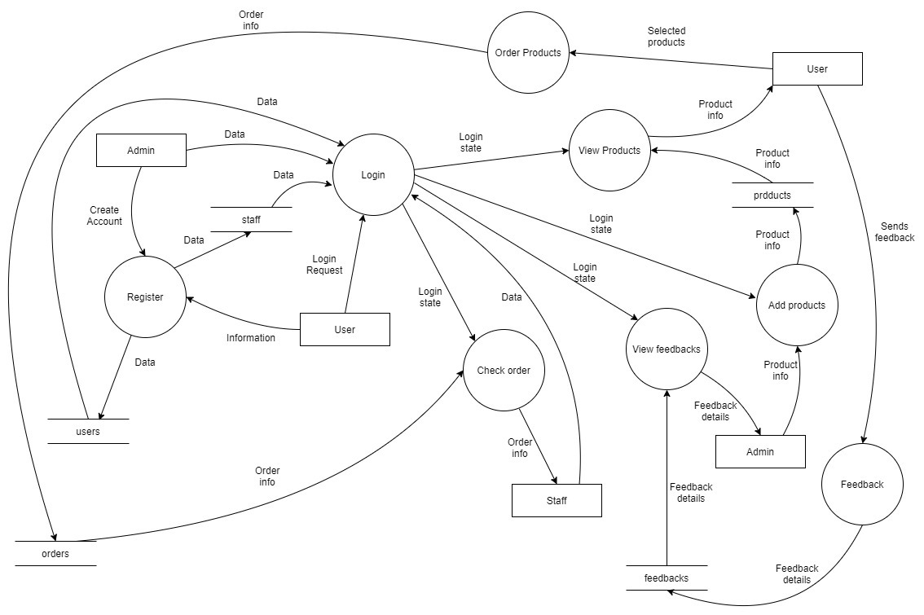
Level 1 Diagram

Slide 10
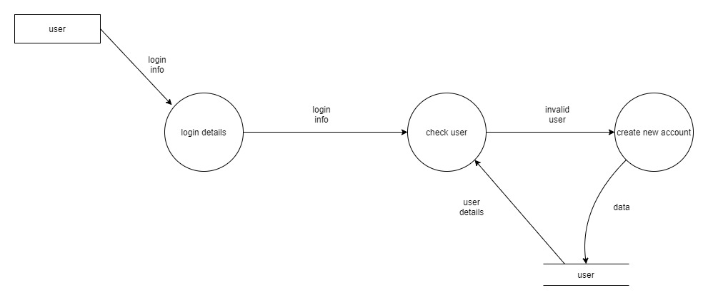
Level 2 Diagram(For Login Process)

Slide 11
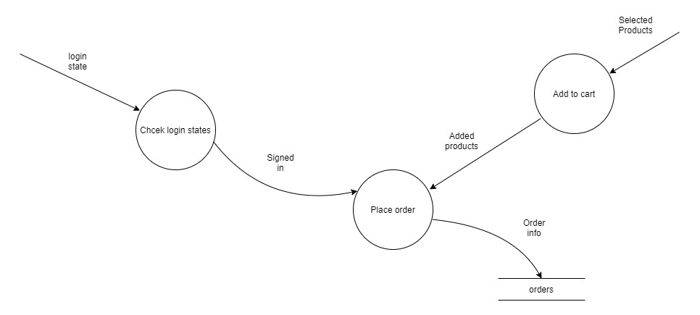
Level 2 Diagram(For Order Products Process)

Slide 12
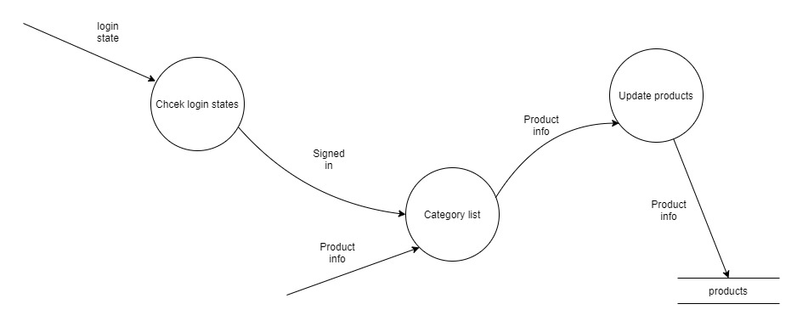
Level 2 Diagram(For Add Products Process)

Slide 13



Use Case Diagram(Actors)
Admin
Staff
User

Slide 14
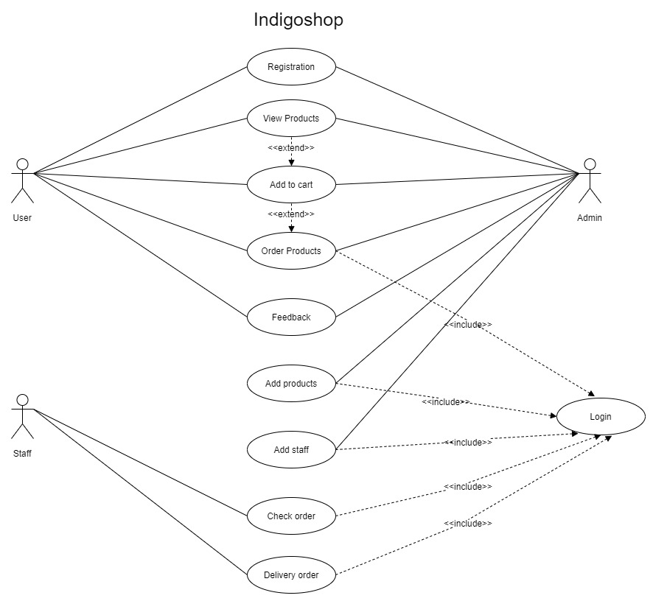
Use Case Diagram

Slide 15

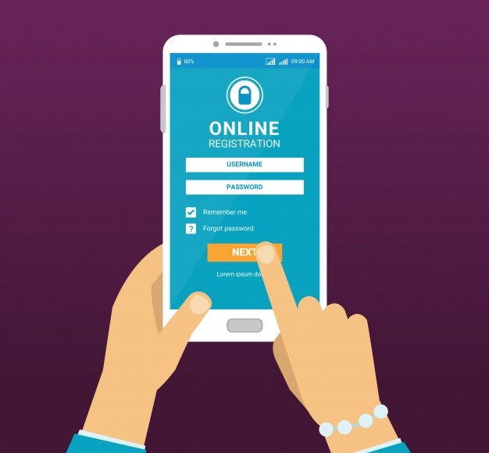
Use Case Narrative
Use Case Title: | Registration
Iteration: | 1
Primary Actor: | User
Goal in context: | To register as our user and to access our application.
Precondition: | Users must have a valid phone number and password.
Trigger: | When users need to order products and use their phone number and password to access our application.
Scenario: | Users go to our application. The system displays main page of the application. The users select register button and the system displays the register form. Users enter their name, phone number, password into register form. The system displays the home page and the user can login from there on.
Exception: | When the registration is successful, the system displays the message, ”User Registered” and then user can login. When the registration is not successfully done , the system will display the error message to allow users to re-enter their information again.
Priority: | High Priority.
When available: | First Increment.
Frequency of use: | Every Day.
Channel to actor: | Android Application.
Secondary actor: | None.
Channels to secondary actors: | None.
Open issues: | The security system from other members.
Details of Use Case Models with Individual use case scenarios and packages.
Use Case diagram for users :

Slide 16
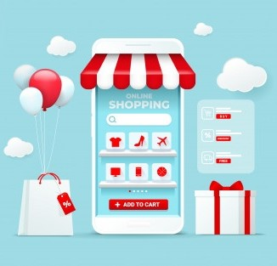
Use Case Narrative
Details of Use Case Models with Individual use case scenarios and packages.
Use Case Title: | View Products
Primary Actor: | Users.
Goal in context: | To see available products of our application in details..
Precondition: | Some products must be available.
Trigger: | When users need to see products of our application.
Scenario: | Users log in to our application. The system displays home page of our application. The Users can view category list of different products of our application. The Users can also view category list of some categorized products such as for clothing and accessories.
Exception: | If the users are not logged in to their account, they will not be able to see our products.
Priority: | High Priority.
When available: | After login.
Frequency of use: | Every Day.
Channel to actor: | Android Application.
Secondary actors: | Admin.
Channels to secondary actors: | Android Application.
Open issues: | None..
Use Case diagram for users :

Slide 17
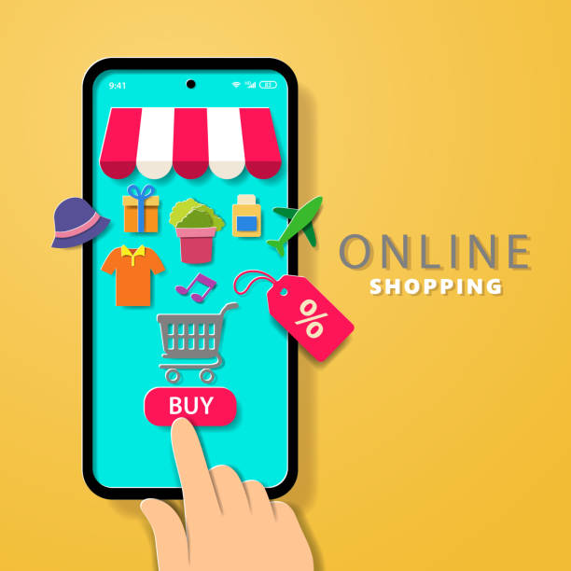
Use Case Narrative
Details of Use Case Models with Individual use case scenarios and packages.
Use Case Title: | Order products
Primary Actor: | Users.
Goal in context: | To purchase products from our application.
Precondition: | Users must be logged in to their account.
Trigger: | When users need to order their selected products from our application.
Scenario: | Users log in to our application. The Users go to home page and the system displays the available products. The users select desired products to add to the cart. The users select Cart button and the system displays the user and product details in the cart. Users write their address and select place order button to confirm ordering products.
Exception: | If the users are not logged in to their account, they will be asked to log in first to order products.
Priority: | High Priority.
When available: | After login.
Frequency of use: | Every Day.
Channel to actor: | Android Application.
Secondary actors: | Staff.
Channels to secondary actors: | Android Application.
Open issues: | The user can order multiple products.
Use Case diagram for users :

Slide 18

Use Case Narrative
Details of Use Case Models with Individual use case scenarios and packages.
Use Case Title: | Add products
Primary Actor: | Admin
Goal in context: | To add more products to sell through our application.
Precondition: | Admin must be logged in to his account.
Trigger: | When new types of products are available in the store.
Scenario: | The admin provides his name and password into the login form to log in to the system The admin selects Add products button to add more products to the application. Admin enters new product name, price, quantity, description, picture to add the product After the product is added by the admin, it is showed to the users through the home page.
Exception: | If the admin is not logged in, he will not be able to add products. The admin cannot update or delete products.
Priority: | High Priority.
When available: | After admin login.
Frequency of use: | Every Day.
Channel to actor: | Android application.
Secondary actors: | Users.
Channels to secondary actors: | Android application.
Open issues: | Showing all the existing product details.
Use Case diagram for admin :

Slide 19
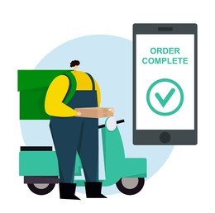
Use Case Narrative
Details of Use Case Models with Individual use case scenarios and packages.
Use Case Title: | Check Order.
Primary Actor: | Staff.
Goal in context: | To check the ordered product by the users.
Precondition: | Staffs must be logged in to their accounts.
Trigger: | When new orders are available.
Scenario: | The staffs provide their name and password into the login form to log in to the system The staff check all the ordered list both ordered and under delivery process. Staffs accept order location wise. Staffs finally see the delivery status.
Exception: | If staffs are not logged in, they will not be able to check ordered details.
Priority: | High Priority.
When available: | After staff login.
Frequency of use: | Every Day.
Channel to actor: | Android application.
Secondary actors: | Users.
Channels to secondary actors: | Android application.
Open issues: | Showing all the existing product details.
Use Case diagram for staff :

Slide 20
Thanks !

